Slide 1
Threads

Slide 2
Overview
A thread is a basic unit of CPU utilization; it comprises a thread ID, a program counter, a register set, and a stack in Thread Control Block (TCB).
It shares with other threads belonging to the same process its code section, data section, and other operating-system resources, such as open files and signals.
A traditional (or heavyweight) process has a single thread of control.
If a process has multiple threads of control, it can perform more than one task at a time.
The figure below illustrates the difference between a traditional single-threaded process and a multithreaded process.

Slide 3
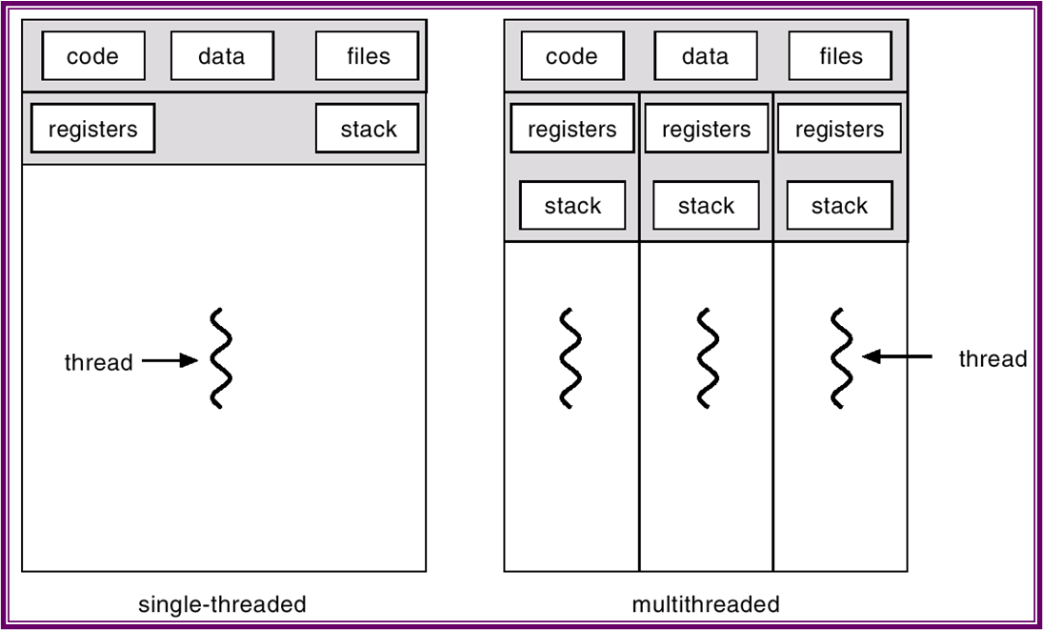
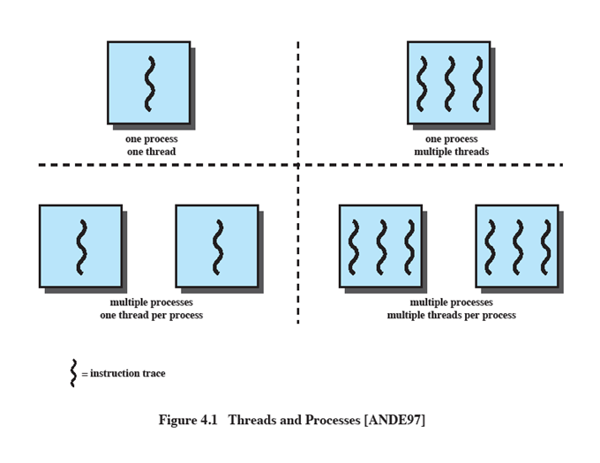
Single and Multithreaded Processes

Slide 4
Multithreading
The ability of an OS to support multiple, concurrent paths of execution within a single process - multithreading.
MS-DOS supports a single user process and a single thread.
Some UNIX, support multiple user processes but only support one thread per process
Java run-time environment is a single process with multiple threads
Multiple processes and threads are found in Windows, Solaris, and many modern versions of UNIX

Slide 5
Motivation
Most software applications that run on modern computers are multithreaded.
An application typically is implemented as a separate process with several threads of control. For example:
A web browser might have one thread display images or text while another thread retrieves data from the network.
A word processor may have a thread for displaying graphics, another thread for responding to keystrokes from the user, and a third thread for performing spelling and grammar checking in the background.
Applications can also be designed to leverage processing capabilities on multicore systems.
Such applications can perform several CPU-intensive tasks in parallel across the multiple computing cores.

Slide 6
Motivation
In certain situations, a single application may be required to perform several similar tasks.
For example, a web server accepts client requests for web pages, images, sound, and so forth.
A busy web server may have several (perhaps thousands of) clients concurrently accessing it.
If the web server ran as a traditional single-threaded process, it would be able to service only one client at a time, and a client might have to wait a very long time for its request to be serviced.
One solution is to have the server run as a single process that accepts requests.
When the server receives a request, it creates a separate process to service that request.

Slide 7
Motivation
In fact, this process-creation method was in common use before threads became popular.
Process creation is time consuming and resource intensive, however.
If the new process will perform the same tasks as the existing process, why incur all that overhead?
It is generally more efficient to use one process that contains multiple threads.
If the web-server process is multithreaded, the server will create a separate thread that listens for client requests.
When a request is made, rather than creating another process, the server creates a new thread to service the request and resume listening for additional requests.

Slide 8
Motivation
Finally, most operating-system kernels are now multithreaded.
Several threads operate in the kernel, and each thread performs a specific task, such as managing devices, managing memory, or interrupt handling.
For example, Solaris has a set of threads in the kernel specifically for interrupt handling;
Linux uses a kernel thread for managing the amount of free memory in the system.

Slide 9
Process vs Threads
Process
A virtual address space which holds the process image
Protected access to
Processors, Other processes, Files, I/O resources
One or More Threads in Process
Each thread has
An execution state (running, ready, etc.)
Saved thread context when not running
An execution stack
Some per-thread static storage for local variables
Access to the memory and resources of its process (all threads of a process share this)

Slide 10
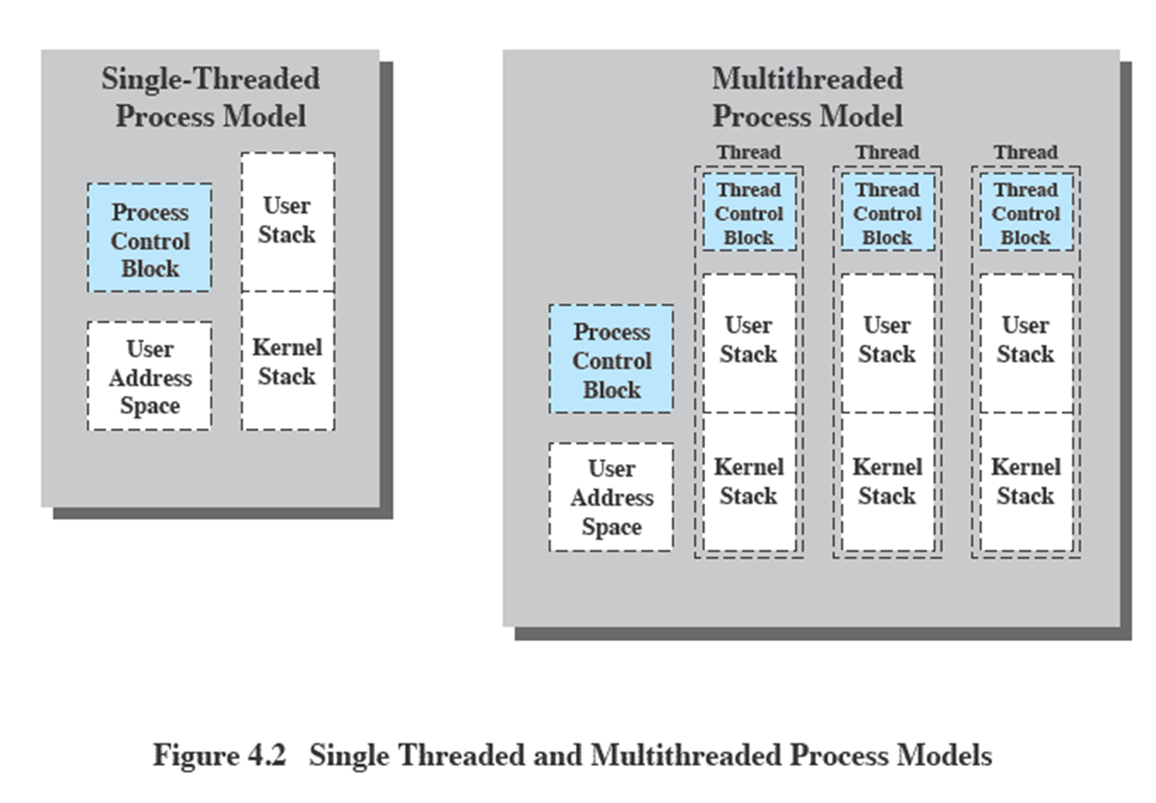
Single Threaded and Multithreaded process model

Slide 11
Benefits of Threads
Takes less time to create a new thread than a process
Less time to terminate a thread than a process
Switching between two threads takes less time that switching processes
Threads can communicate with each other
without invoking the kernel
Responsiveness.
Multithreading an interactive application may allow a program to continue running even if part of it is blocked or is performing a lengthy operation, thereby increasing responsiveness to the user.

Slide 12
Benefits of Threads
Resource sharing.
Processes can only share resources through techniques such as shared memory and message passing.
Such techniques must be explicitly arranged by the programmer.
However, threads share the memory and the resources of the process to which they belong by default.
The benefit of sharing code and data is that it allows an application to have several different threads of activity within the same address space.

Slide 13
Benefits of Threads
Economy.
Allocating memory and resources for process creation is costly.
Because threads share the resources of the process to which they belong, it is more economical to create and context-switch threads.
In Solaris, for example, creating a process is about thirty times slower than is creating a thread, and context switching is about five times slower.
Scalability.
The benefits of multithreading can be even greater in a multiprocessor architecture, where threads may be running in parallel on different processing cores.
A single-threaded process can run on only one processor, regardless how many are available.

Slide 14
Threads
Several actions that affect all of the threads in a process
The OS must manage these at the process level.
Examples:
Suspending a process involves suspending all threads of the process(ULT)
Termination of a process, terminates all threads within the process
Threads have execution states and may synchronize with one another.
Similar to processes
We look at these two aspects of thread functionality in turn.
States
Synchronization

Slide 15
Thread Execution States
States associated with a change in thread state
Spawn (another thread)
Block
Issue: will blocking a thread block other, or all, threads
Unblock
Ready
Running
Finish (thread)
Deallocate register context and stacks

Slide 16
Thread Synchronization
All the threads of a process share the same address space and other resources such as open files.
Any alteration of a resource by one thread affects the environment of the other threads in the same process
It is therefore necessary to synchronize the activities of various threads so that they do not interfere with each other or corrupt data structures.
Ex:
If two threads each try to add an element to a doubly linked list at same time, one element may be lost or the list may end up malformed.

Slide 17
Types of threads
User Level Thread (ULT)
Kernel level Thread (KLT) also called:
kernel-supported threads
lightweight processes

Slide 18
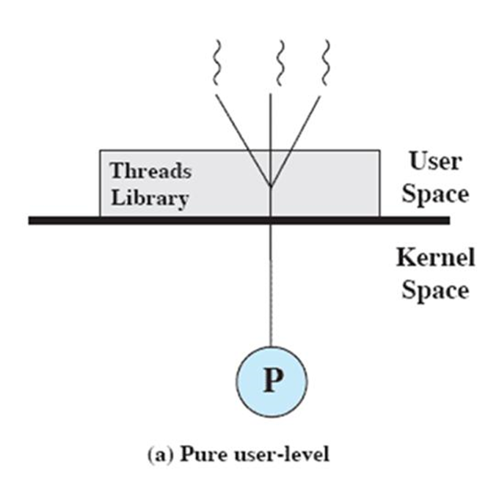
User-Level Threads
All thread management is done by the application
The kernel is not aware of the existence of threads
Any application can be programmed to be multithreaded by using threads library
By default, application begins with single thread of execution
At run time application may spawn a new thread within the process using thread library

Slide 19
User-Level Threads
The thread library creates a data structure for new thread and passes control to one of the threads in ready state within the process using a scheduling algorithm.
Whenever control passed to thread library, context of the current thread saved and when control is passed from library to a thread, the context of that thread (user registers, program counter and stack pointer) restored.
The kernel unaware of this thread activity continues to schedule the process as a unit and assigns a single execution state to that process.

Slide 20
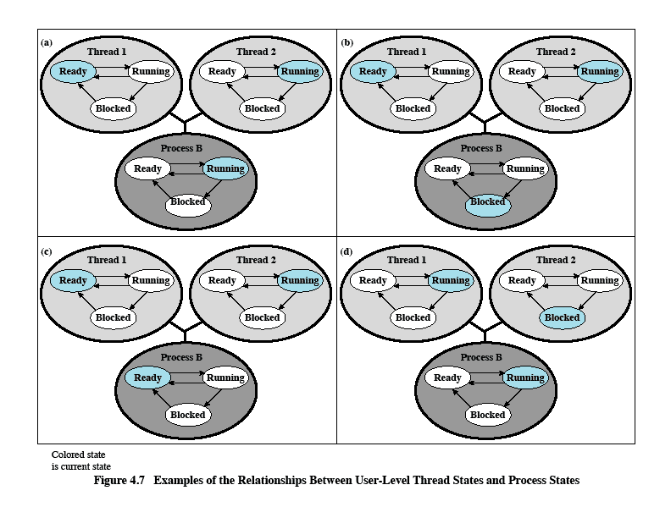
Relationships between ULT Thread and Process States

Slide 21
Relationships between ULT Thread and Process States
Process B executing in its thread 2; and the state of process and its two ULTs are shown in Figure 4.7(a)
The application executing in thread 2 makes a system call that blocks B.
For eg: I/O call is made.
Process B now placed in blocked state.
So process switching happens.
According to data structure maintained by thread library, thread 2 of process B still in the Running state.

Slide 22
Relationships between ULT Thread and Process States
A clock interrupt passes control to the kernel, and the kernel determines that the currently running process has exhausted its time slice.
The kernel places process B in ready state and switches to another process.
But according to data structure maintained by thread library, thread 2 of process B is still in running state.
Thread 2 has reached a point where it needs some action performed by thread 1 of process B.
Thread 2 enters a blocked state and thread 1 transitions from ready to running.
The process itself remains in the Running state.

Slide 23
Advantages of ULTs
Thread switching does not require kernel mode privileges (no mode switches)
Thread Scheduling can be application specific
ULTs can run on any OS
Notes:
There are a number of advantages to the use of ULTs instead of KLTs, including the following:
1. Thread switching does not require kernel mode privileges because all of the
thread management data structures are within the user address space of a single process. Therefore, the process does not switch to the kernel mode to do thread management. This saves the overhead of two mode switches (user to kernel; kernel back to user).
2. Scheduling can be application specific. One application may benefit most
from a simple round-robin scheduling algorithm, while another might benefit from a priority-based scheduling algorithm. The scheduling algorithm can be tailored to the application without disturbing the underlying OS scheduler.
3. ULTs can run on any OS. No changes are required to the underlying kernel
to support ULTs. The threads library is a set of application-level functions shared by all applications.

Slide 24
Disadvantages of ULTs
In a typical OS many system calls are blocking
as a result, when a ULT executes a system call, not only is that thread blocked, but all of the threads within the process are blocked
In a pure ULT strategy, a multithreaded application cannot take advantage of multiprocessing
Notes:
There are two distinct disadvantages of ULTs compared to KLTs:
1. In a typical OS, many system calls are blocking. As a result, when a ULT
executes a system call, not only is that thread blocked, but also all of the threads within the process are blocked.
2. In a pure ULT strategy, a multithreaded application cannot take advantage
of multiprocessing. A kernel assigns one process to only one processor at a time. Therefore, only a single thread within a process can execute at a time. In effect, we have application-level multiprogramming within a single process. While this multiprogramming can result in a significant speedup of the application, there are applications that would benefit from the ability to execute portions of code simultaneously.

Slide 25
Overcoming ULT Disadvantages
Jacketing –> Application-level routine
converts a blocking system call into a non-blocking system call (like checking for I/O device status before initiating an I/O request)
Writing an application as multiple processes rather than multiple threads
Notes:
There are ways to work around these two problems. For example, both problems can be overcome by writing an application as multiple processes rather than multiple threads. But this approach eliminates the main advantage of threads: Each switch becomes a process switch rather than a thread switch, resulting in much
greater overhead. Another way to overcome the problem of blocking threads is to use a technique referred to as jacketing . The purpose of jacketing is to convert a blocking
system call into a non-blocking system call. For example, instead of directly calling a system I/O routine, a thread calls an application-level I/O jacket routine. Within this jacket routine is code that checks to determine if the I/O device is busy. If it is, the thread enters the Blocked state and passes control (through the threads library) to another thread. When this thread later is given control again, the jacket routine checks the I/O device again.

Slide 26
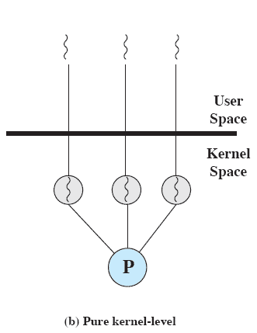
Kernel-Level Threads (KLTs)
Thread management is done by the kernel
The kernel maintains the context information of a process in whole, as well as thread context within the process
no thread management is done by the application
Windows is an example of this approach
Notes:
KERNEL-LEVEL THREADS
In a pure KLT facility, all of the work of thread management is done by the kernel. There is no thread management code in the application level, simply an application programming interface (API) to the kernel thread facility. Windows is an example of this approach. Figure 4.5b depicts the pure KLT approach. The kernel maintains context
information for the process as a whole and for individual threads within the process.

Slide 27
Advantages of KLTs
The kernel can simultaneously schedule multiple threads from the same process on multiple processors
If one thread in a process is blocked, the kernel can schedule another thread of the same process
Kernel routines themselves can be multithreaded
Notes:
Scheduling by the kernel is done on a thread basis. This approach overcomes the two principal drawbacks of the ULT approach. First, the kernel can simultaneously schedule multiple threads from the same process on multiple processors. Second, if one thread in a process is blocked, the kernel can schedule another thread of the same process. Another advantage of the KLT approach is that kernel routines themselves can be multithreaded.

Slide 28
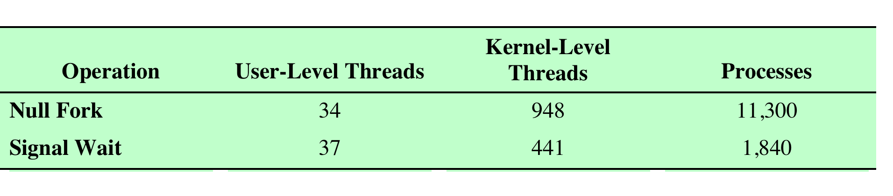

Disadvantage of KLTs
The transfer of control from one thread to another within the same process requires a mode switch to the kernel
Notes:
The principal disadvantage of the KLT approach compared to the ULT approach is that the transfer of control from one thread to another within the same process requires a mode switch to the kernel. To illustrate the differences, Table 4.1 shows the results of measurements taken on a uniprocessor VAX computer running a UNIX-like OS. The two benchmarks are as follows: Null Fork, the time to create, schedule, execute, and complete a process/thread that invokes the null procedure (i.e., the overhead of forking a process/thread); and Signal-Wait, the time for a process/thread to signal a waiting process/thread and then wait on a condition (i.e., the overhead of synchronizing two processes/threads together). We see that there is
an order of magnitude or more of difference between ULTs and KLTs and similarly between KLTs and processes.

Slide 29
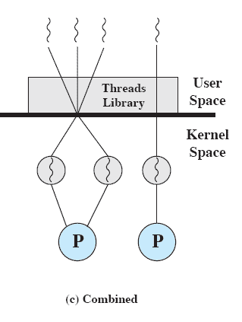
Combined Approaches
Thread creation is done in the user space
Bulk of scheduling and synchronization of threads is by the application
Multiple ULTs from a single application are mapped on to some number of KLTs
Multiple threads of same application can run in parallel on multiple processors
Advantages of both ULT and KLT.
Solaris is an example
Notes:
COMBINED APPROACHES
Some operating systems provide a combined ULT/ KLT facility ( Figure 4.5c ). In a combined system, thread creation is done completely in user space, as is the bulk of the scheduling and synchronization of threads within an application. The multiple ULTs from a single application are mapped onto some (smaller or equal) number of KLTs. The programmer may
adjust the number of KLTs for a particular application and processor to achieve the best overall results. In a combined approach, multiple threads within the same application can run in parallel on multiple processors, and a blocking system call need not block the entire process. If properly designed, this approach should combine the advantages of the pure ULT and KLT approaches while minimizing the disadvantages. Solaris is a good example of an OS using this combined approach. The current Solaris version limits the ULT/KLT relationship to be one-to-one.

Slide 30
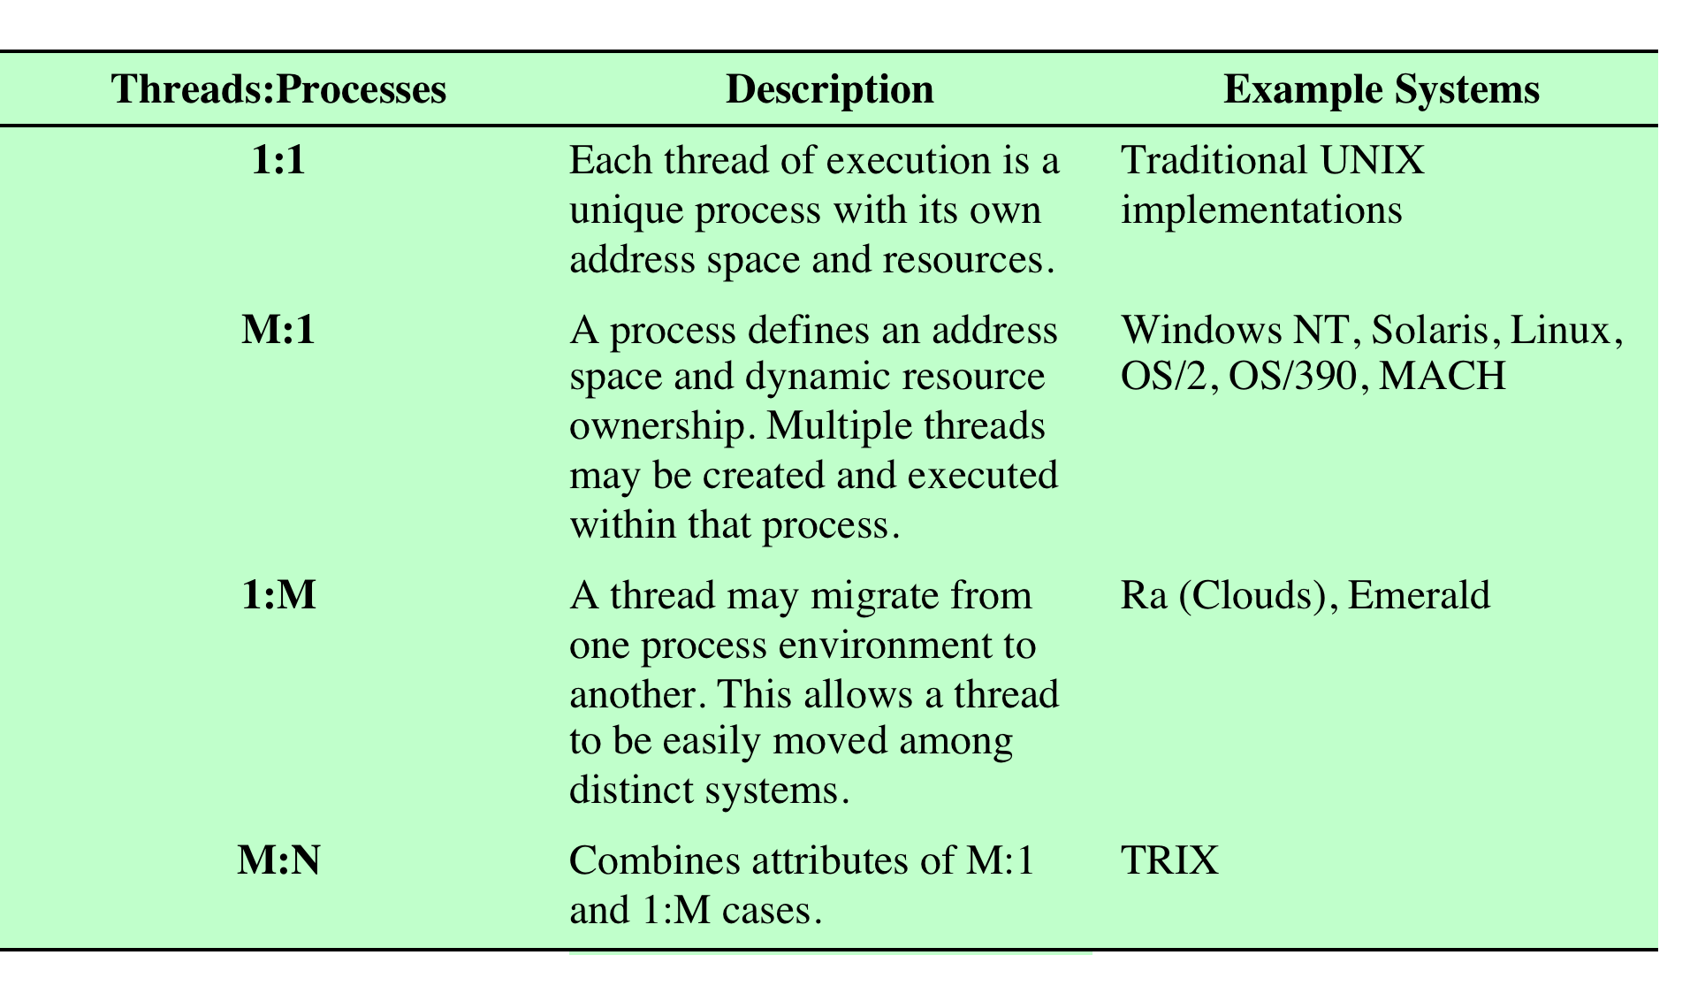
Relationship Between Threads and Processes
Table 4.2 Relationship between Threads and Processes
Notes:
As we have said, the concepts of resource allocation and dispatching unit have traditionally been embodied in the single concept of the process—that is, as a 1 : 1
relationship between threads and processes. Recently, there has been much interest in providing for multiple threads within a single process, which is a many-toone
relationship. However, as Table 4.2 shows, the other two combinations have also been investigated, namely, a many-to-many relationship and a one-to-many relationship.
The idea of having a many-to-many relationship between threads and processes has been explored in the experimental operating system TRIX [PAZZ92, WARD80]. In TRIX, there are the concepts of domain and thread. A domain is a static entity, consisting of an address space and “ports” through which messages may be sent and received. A thread is a single execution path, with an execution stack, processor state, and scheduling information.
As with the multithreading approaches discussed so far, multiple threads may execute in a single domain, providing the efficiency gains discussed earlier. However, it is also possible for a single user activity, or application, to be performed in multiple domains. In this case, a thread exists that can move from one domain to another.

Slide 31
Multithreading Models
Many-to-One
One-to-One
Many-to-Many

Slide 32
Many-to-One
Many user-level threads mapped to single kernel thread.
Used on systems that do not support kernel threads.
Thread management is done by the thread library in user space, so it is efficient.
However, the entire process will block if a thread makes a blocking system call.
Also, because only one thread can access the kernel at a time, multiple threads are unable to run in parallel on multicore systems.

Slide 33
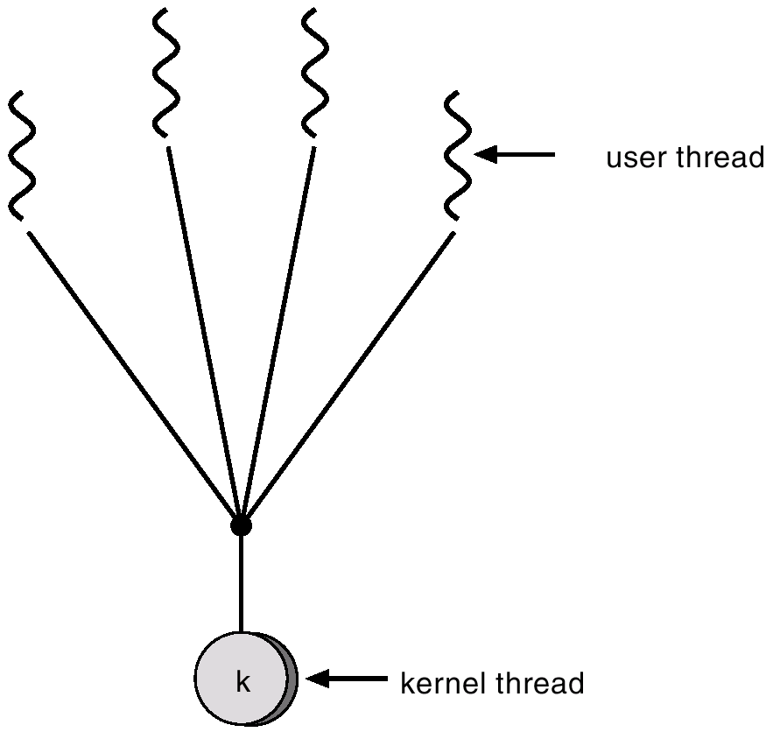
Many-to-One Model

Slide 34
One-to-One
Each user-level thread maps to kernel thread.
It provides more concurrency than the many-to-one model by allowing another thread to run when a thread makes a blocking system call.
It also allows multiple threads to run in parallel on multiprocessors.
The only drawback to this model is that creating a user thread requires creating the corresponding kernel thread.
Because the overhead of creating kernel threads can burden the performance of an application, most implementations of this model restrict the number of threads supported by the system.
Examples
- Windows 95/98/NT/2000 , OS/2

Slide 35
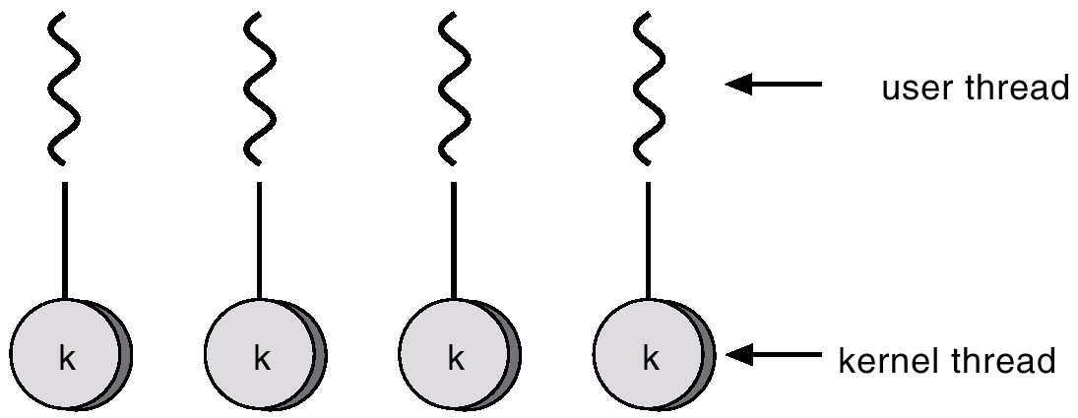
One-to-one Model

Slide 36
Many-to-Many Model
Allows many user level threads to be mapped to many kernel threads.
Allows the operating system to create a sufficient number of kernel threads.
The number of kernel threads may be specific to either a particular application or a particular machine (an application may be allocated more kernel threads on a multiprocessor than on a single processor).
Solaris 2
Windows NT/2000 with the ThreadFiber package

Slide 37
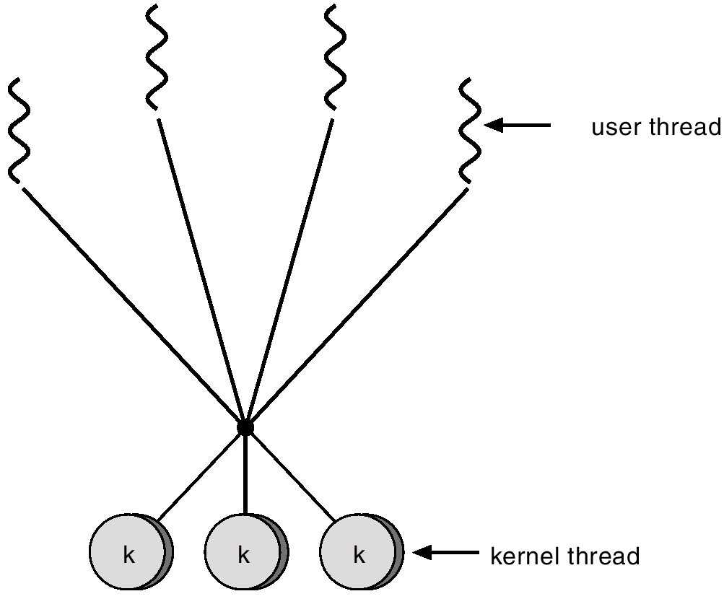
Many-to-Many Model

Slide 38
Thread Libraries
A thread library provides the programmer with an API for creating and managing threads.
There are two primary ways of implementing a thread library.
The first approach is to provide a library entirely in user space with no kernel support.
All code and data structures for the library exist in user space.
This means that invoking a function in the library results in a local function call in user space and not a system call.

Slide 39
Thread Libraries
The second approach is to implement a kernel-level library supported directly by the operating system.
In this case, code and data structures for the library exist in kernel space.
Invoking a function in the API for the library typically results in a system call to the kernel.
Three main thread libraries are in use today:
POSIX Pthreads, Windows, and Java.

Slide 40
Thread Libraries
Pthreads, the threads extension of the POSIX standard, may be provided as either a user-level or a kernel-level library.
The Windows thread library is a kernel-level library available on Windows systems.
The Java thread API allows threads to be created and managed directly in Java programs.
However, because in most instances the JVM is running on top of a host operating system, the Java thread API is generally implemented using a thread library available on the host system.
This means that on Windows systems, Java threads are typically implemented using the Windows API; UNIX and Linux systems often use Pthreads.

Slide 41
Thread Libraries – Pthreads in Linux and Unix

Slide 42
Questions
How many child process are created here?
Total number of processes?
void main()
{
fork();
fork();
fork();
}

Slide 43
Thread Scheduling
One distinction between user-level and kernel-level threads lies in how they are scheduled.
On systems implementing the many-to-one and many-to-many models, the thread library schedules user-level threads to run on an available Light Weight Process(LWP).
This scheme is known as process contention scope (PCS), since competition for the CPU takes place among threads belonging to the same process.
(When we say the thread library schedules user threads onto available LWPs, we do not mean that the threads are actually running on a CPU. That would require the operating system to schedule the kernel thread onto a physical CPU.)

Slide 44
Thread Scheduling
To decide which kernel-level thread to schedule onto a CPU, the kernel uses system-contention scope (SCS).
Competition for the CPU with SCS scheduling takes place among all threads in the system.
Systems using the one-to-one model, such as Windows, Linux, and Solaris, schedule threads using only SCS.
Typically, PCS is done according to priority—the thread library scheduler selects the runnable thread with the highest priority to run.
User-level thread priorities are set by the programmer and are not adjusted by the thread library, although some thread libraries may allow the programmer to change the priority of a thread.
It is important to note that PCS will typically preempt the thread currently running in favor of a higher-priority thread; however, there is no guarantee of time slicing among threads of equal priority.

Slide 45
Pthread Scheduling
Pthreads identifies the following contention scope values:
PTHREAD_SCOPE_PROCESS schedules threads using PCS scheduling.
PTHREAD_SCOPE_SYSTEM schedules threads using SCS scheduling.
On systems implementing the many-to-many model, the PTHREAD_SCOPE_PROCESS policy schedules user-level threads onto available LWPs.
The number of LWPs is maintained by the thread library, perhaps using scheduler activations.
The PTHREAD_SCOPE_SYSTEM scheduling policy will create and bind an LWP for each user-level thread on many-to-many systems, effectively mapping threads using the one-to-one policy.

Slide 46
Pthread Scheduling
The Pthread IPC provides two functions for getting—and setting—the contention scope policy:
pthread_attr_setscope(pthread attr_t *attr, int scope)
pthread_attr_getscope(pthread attr_t *attr, int *scope)
The first parameter for both functions contains a pointer to the attribute set for the thread.
The second parameter for the pthread_attr_setscope() function is passed either the PTHREAD_SCOPE_SYSTEM or the PTHREAD_SCOPE_PROCESS value, indicating how the contention scope is to be set.
In the case of pthread_attr_getscope(), this second parameter contains a pointer to an int value that is set to the current value of the contention scope.
If an error occurs, each of these functions returns a nonzero value.

Slide 47
Sample pthread pgm using contention scope

Slide 48
Threading Issues
The fork() and exec() System Calls
Signal Handling
Thread Cancellation
Thread-Local Storage
Scheduler Activations
One scheme for communication between the user-thread library and the kernel is known as scheduler activation.
It works as follows: The kernel provides an application with a set of virtual processors (LWPs), and the application can schedule user threads onto an available virtual processor.
Furthermore, the kernel must inform an application about certain events.

